Slide 1
Implicit Regularization in Nonconvex Statistical Estimation
By: Qianyi Che, Zeheng Song, Shengxuan Chen, Patrick Di Rita, Yunshen Huang
CSE 534A Large-Scale Optimization (Student Presentation)

Slide 2
Contents
Introduction & Motivation
Regularized V.S. unregularized gradient method
A glimpse of implicit regularization
Results
Phase retrieval
Low-rank matrix completion
Blind deconvolution
General recipe for trajectory analysis
Discussion & Insights

Slide 3
Contents
Introduction & Motivation
Regularized V.S. unregularized gradient method
A glimpse of implicit regularization
Results
Phase retrieval
Low-rank matrix completion
Blind deconvolution
General recipe for trajectory analysis
Discussion & Insights

Slide 4




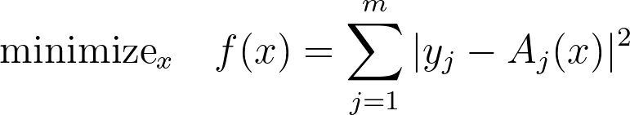
Introduction -- nonlinear systems
We are interested in
Collected a set of data points
Priori nonlinear map
Object of interest
The reconstruction of is wanted!
Minimize the empirical loss
Normally, nonconvex and NP-hard!

Slide 5

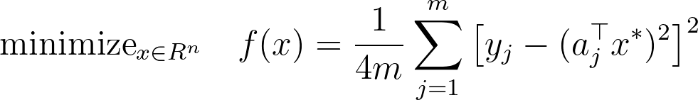
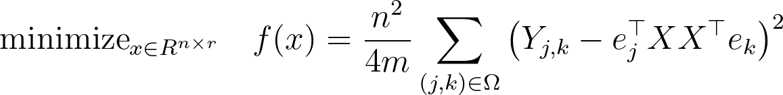

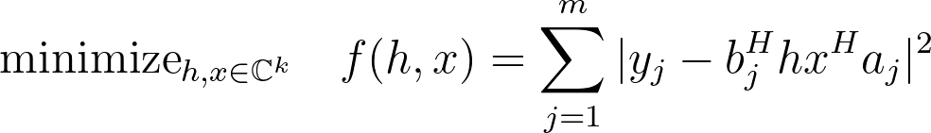
Nonconvex optimization problems -- examples
Phase retrieval
Low-rank matrix completion
Blind deconvolution

Slide 6


Nonconvex optimization via regularized GDM
Normal gradient descent method
Carefully choose initialization and learning rate
Improving computational convergence by enforcing proper regularization (Regularized Gradient Descent)
Trimming / truncation
Regularized loss
Projection
And more

Slide 7
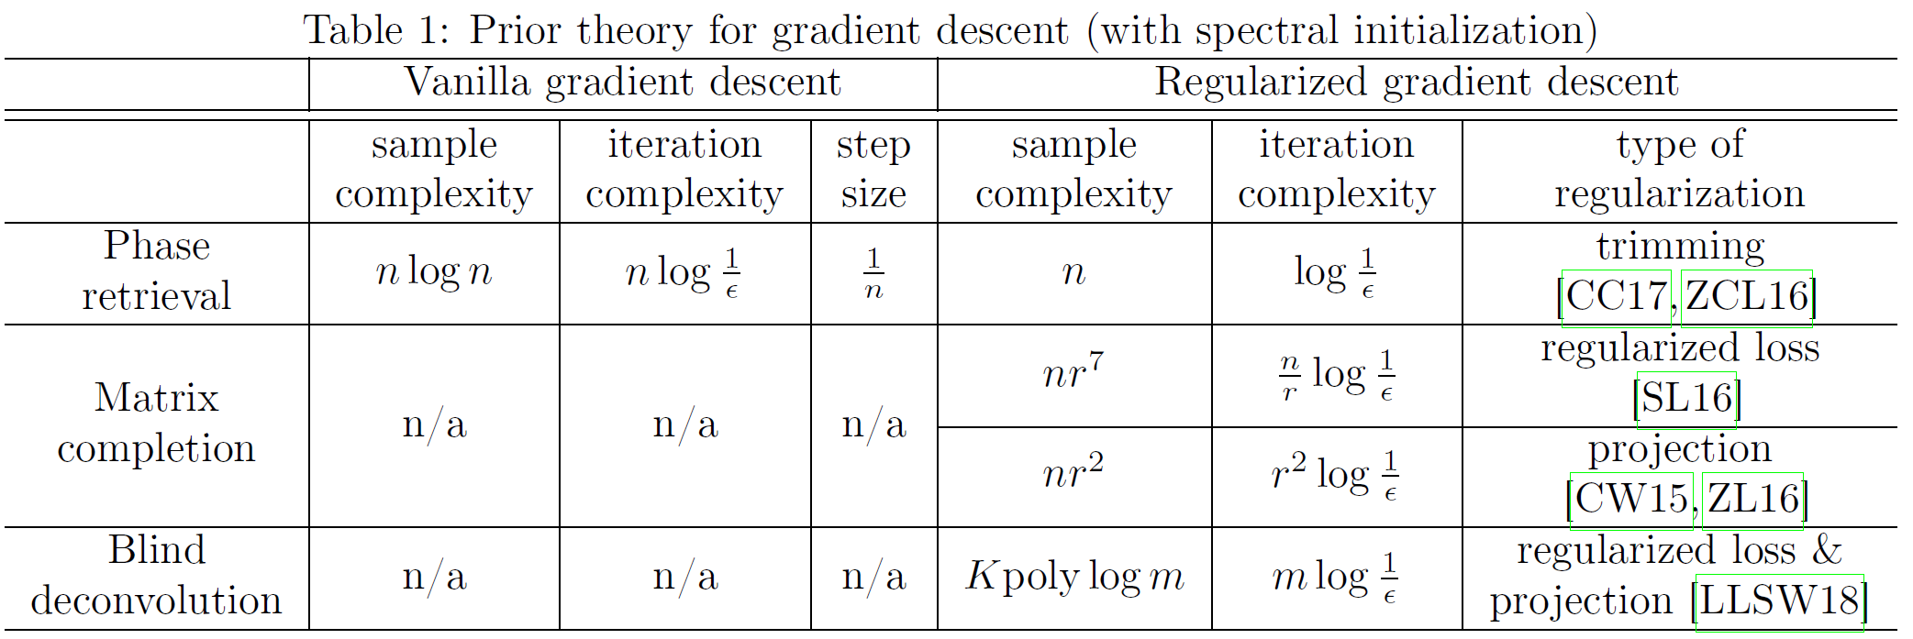
Nonconvex optimization via regularized GM
RGDM has much better convergence guarantee than GDM on these three optimization problems
Or is it?

Slide 8
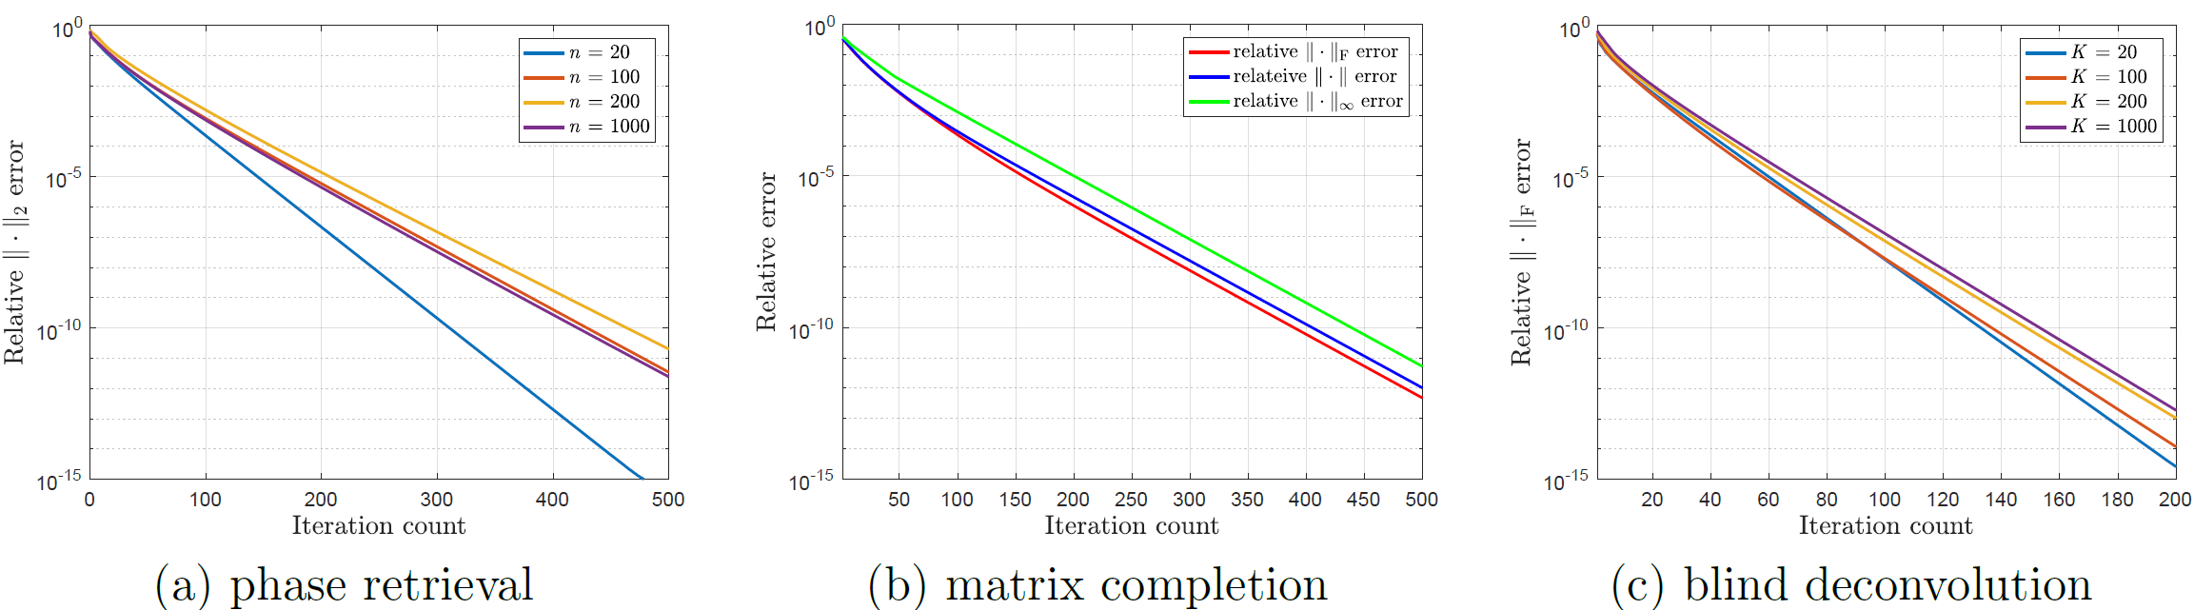
Numerical surprise of unregularized GDM
With varying problem size and fixed step size, GDM enjoys linear convergence

Slide 9
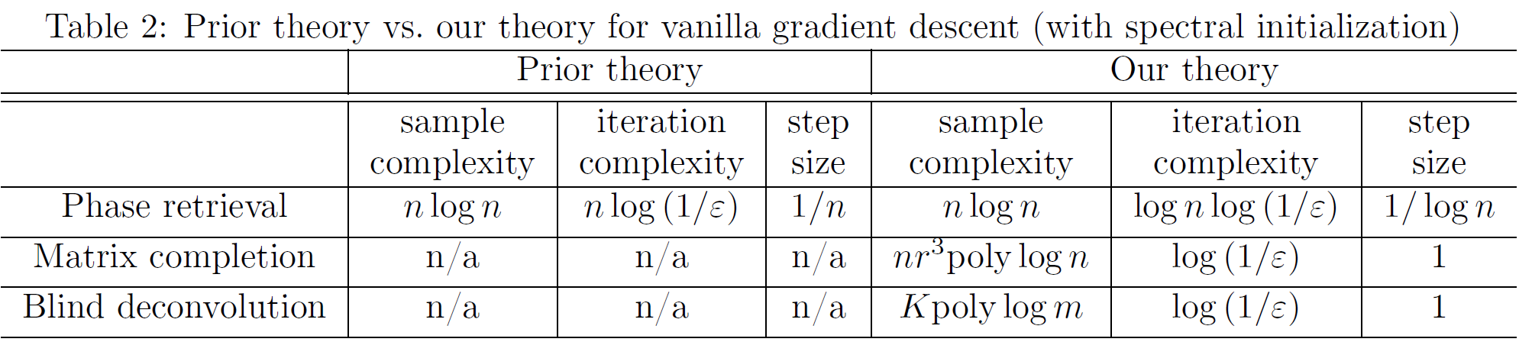
Numerical surprise of unregularized GDM
But why?
RGDM achieve certain incoherence conditions in execution
GDM automatically forces the iterates to stay incoherence, thus implicitly regularizing the search directions

Slide 10
Contents
Introduction & Motivation
Regularized V.S. unregularized gradient method
A glimpse of implicit regularization
Results
Phase retrieval
Low-rank matrix completion
Blind deconvolution
General recipe for trajectory analysis
Discussion & Insights

Slide 11





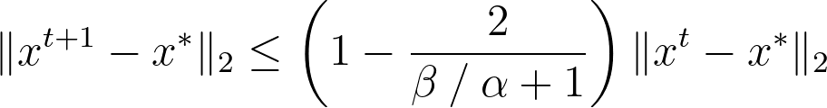
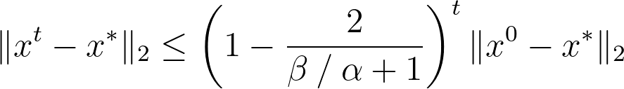
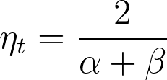
Revisited GDM
A twice continuously differentiable function is said to be -strongly convex for if
A twice continuously differentiable function is said to be -smooth for if
For the objection function is -strongly convex and -smooth

Slide 12

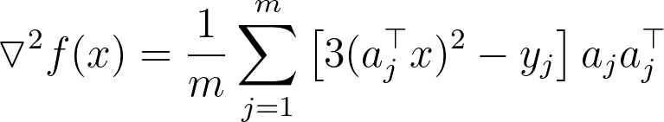

Local geometry explanation (on phase retrieval)
The convergence guarantee can be extended to local conditions over ball centered at
Consider solving phase retrieval problem
With an infinite number of samples

Slide 13
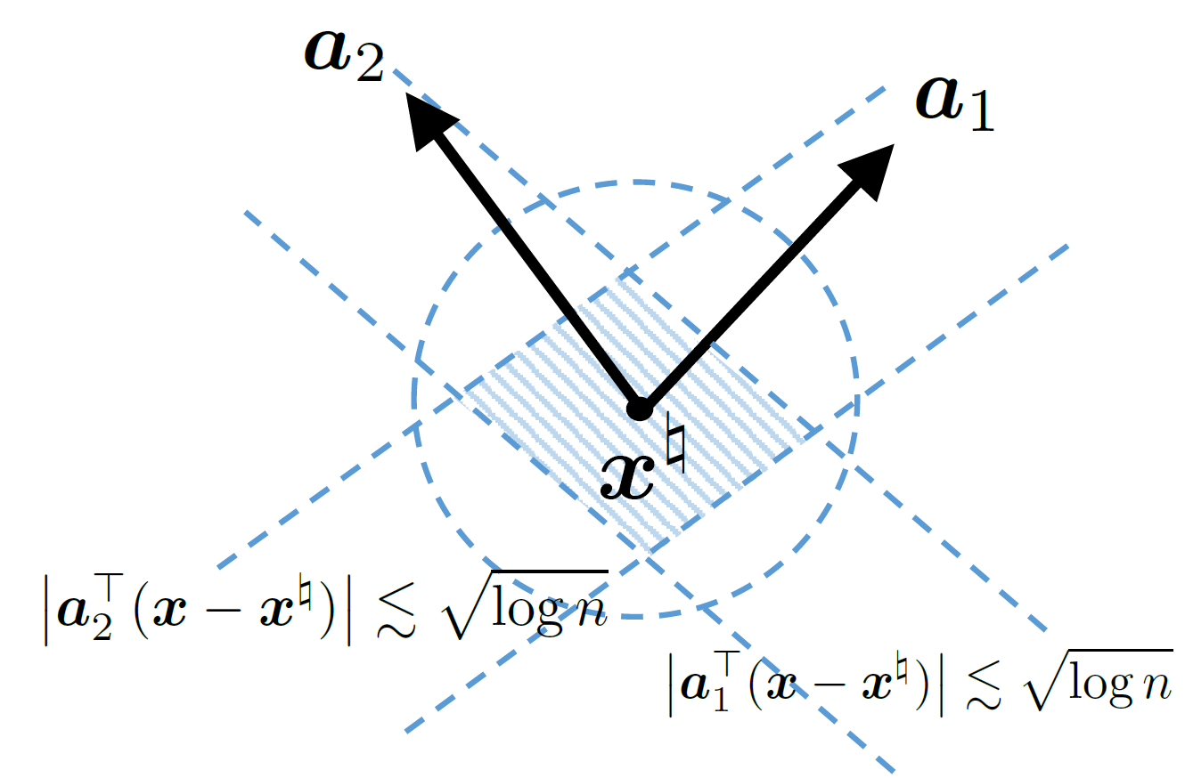



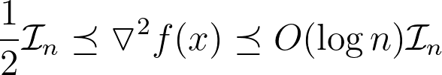
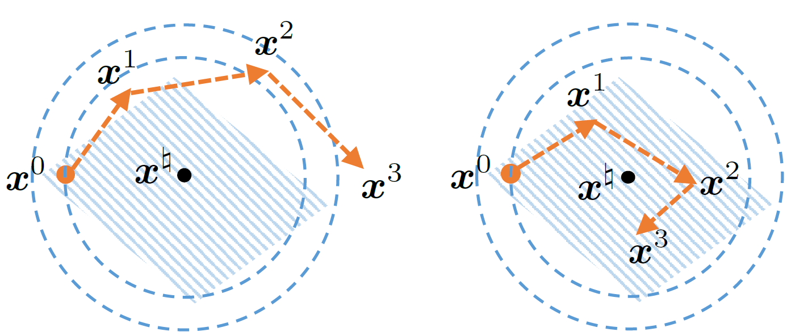

Local geometry explanation (on phase retrieval)
Paper identifies a local region as the intersection of an ball and a polytope, which is called region of incoherence and contraction (RIC)
For phase retrieval, RIC includes all points residing
For x in the RIC, with high probability
For x in the RIC, safy fixed step size

Slide 14

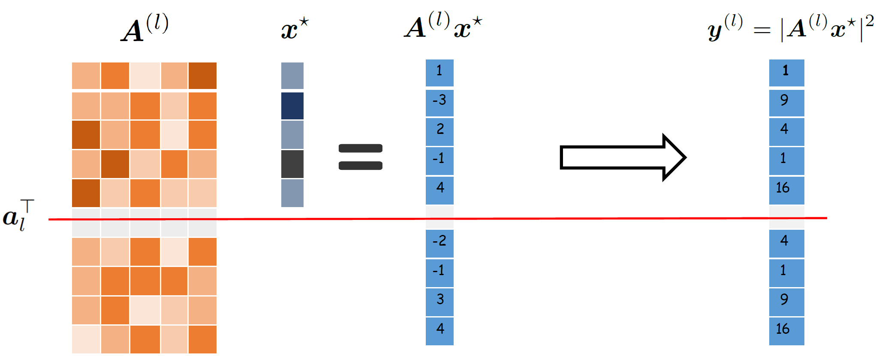
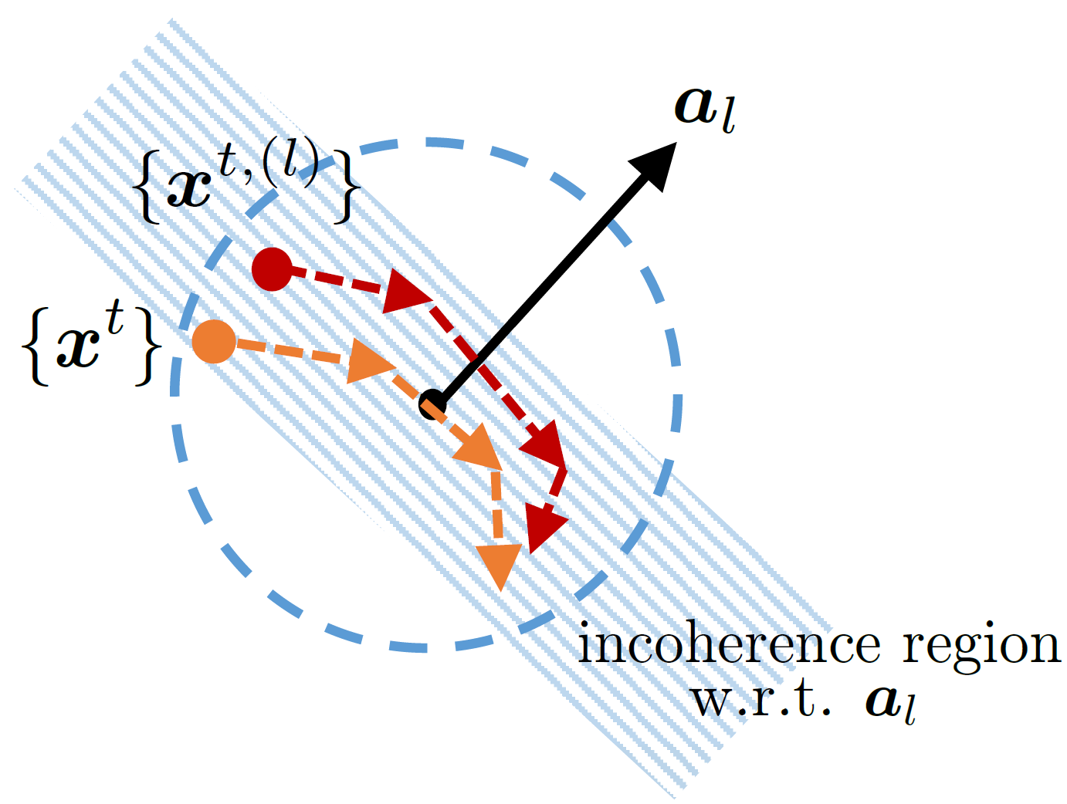
leave-one-out trick (on phase retrieval)
Widely used in statistic and random matrix theory
Since is independent with , it is much easier to control RIC

Slide 15
Contents
Introduction & Motivation
Regularized V.S. unregularized gradient method
A glimpse of implicit regularization
Results
Phase retrieval
Low-rank matrix completion
Blind deconvolution
General recipe for trajectory analysis
Discussion & Insights

Slide 16
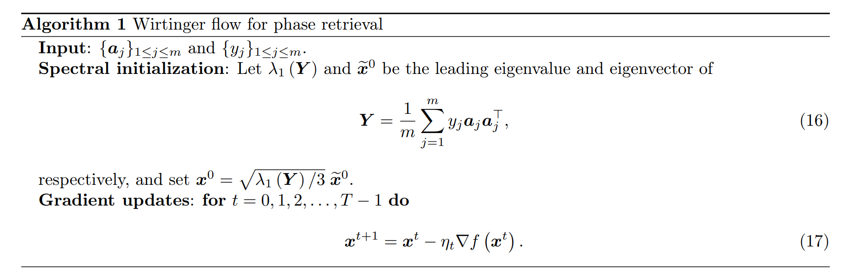
Phase retrieval
Solving quadratic systems of equations

Slide 17
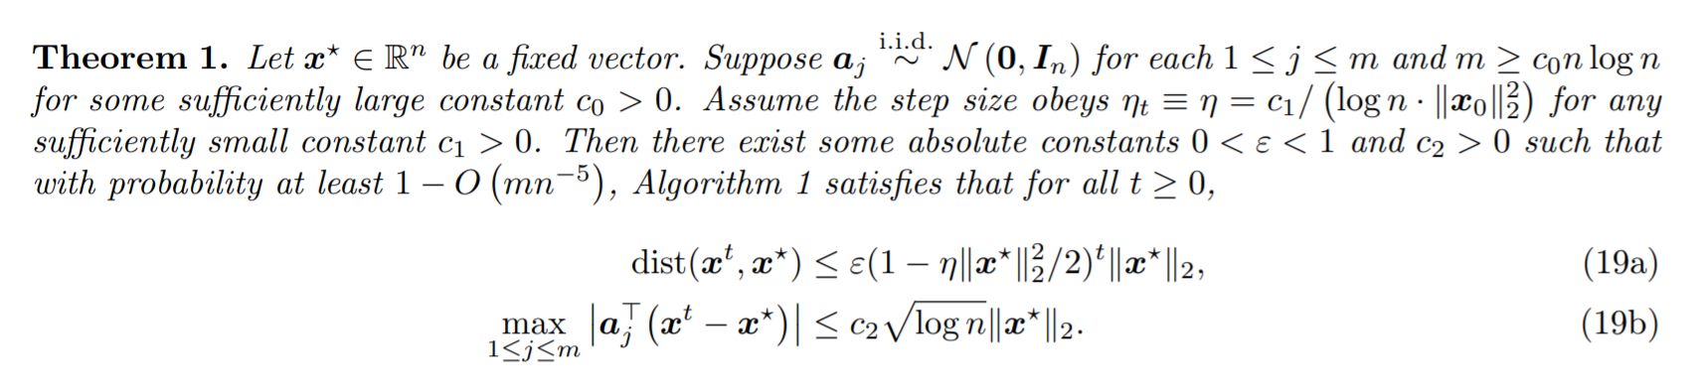
Theorem 1
Indicates the incoherence properties

Slide 18
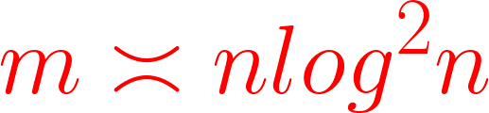
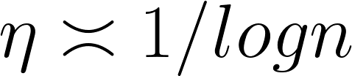

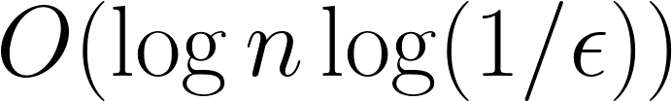
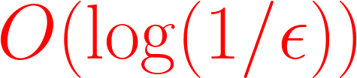
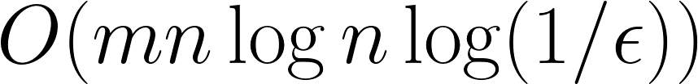

Near-optimal statistical and computational
Implicit regularization
Near-constant step size if
Step size
Iteration complexity
Computational complexity
Incoherence of spectral initialization
The initial guess falls within the RIC
And is hence nearly orthogonal to all design vectors

Slide 19
Contents
Introduction & Motivation
Regularized V.S. unregularized gradient method
A glimpse of implicit regularization
Results
Phase retrieval
Low-rank matrix completion
Blind deconvolution
General recipe for trajectory analysis
Discussion & Insights

Slide 20
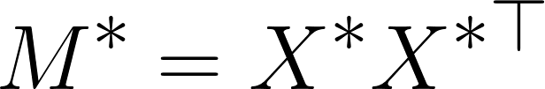
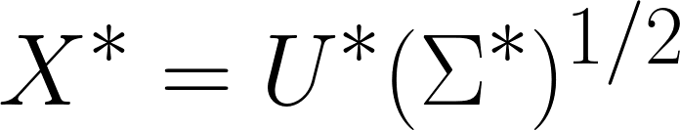
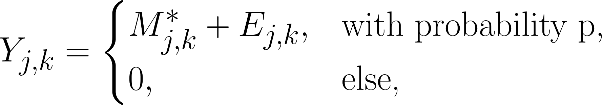
Low-Rank Matrix Completion
A positive semidefinite matrix with rank r has its eigendecomposition factorized as , where
.
For a random sampling model such that each entry of M* is observed independently with probability 0 < p ≤ 1, then we have for 1 ≤ j ≤ k ≤ n,

Slide 21
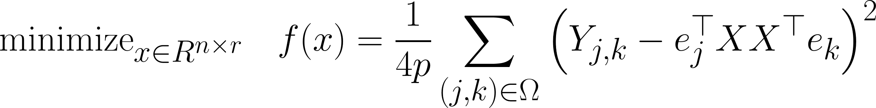
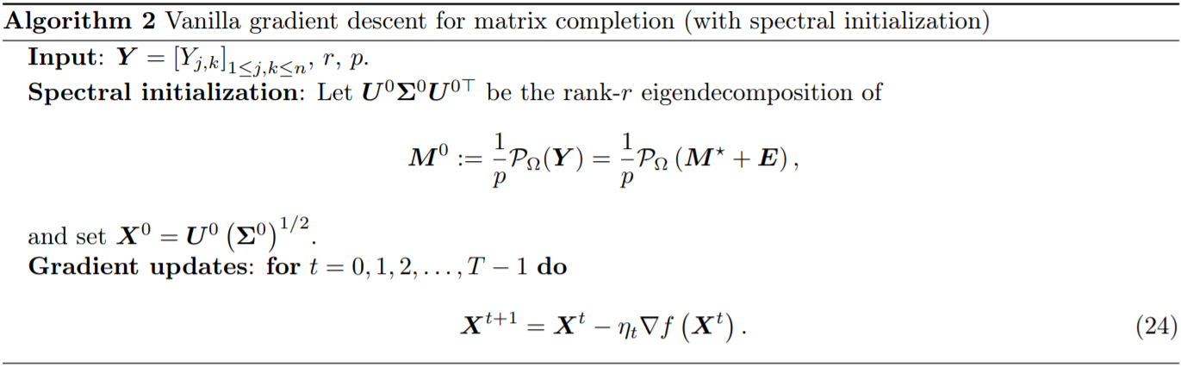
Low-Rank Matrix Completion
For the nonconvex optimization problem

Slide 22
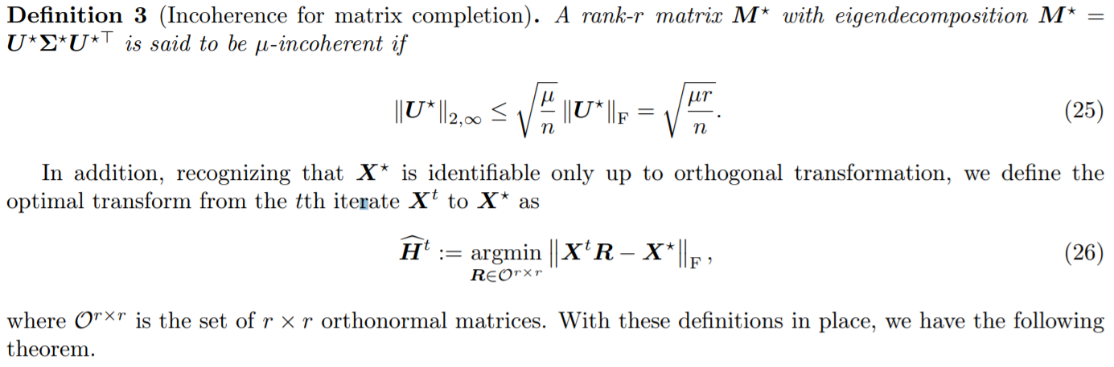
Low-Rank Matrix Completion
A standard incoherence parameter is required for the matrix completion

Slide 23
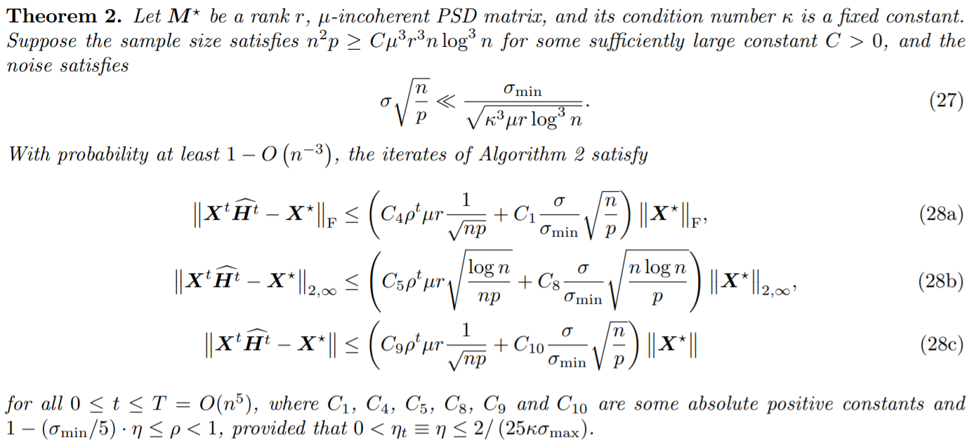
Low-Rank Matrix Completion
Main theorem

Slide 24
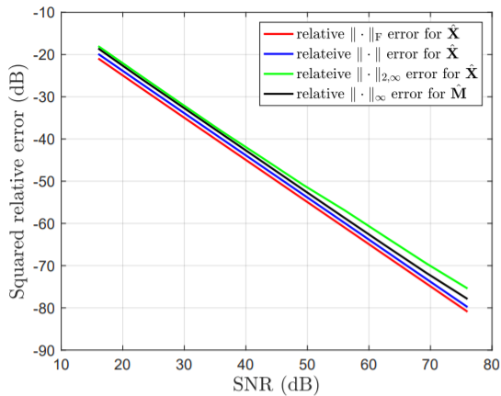
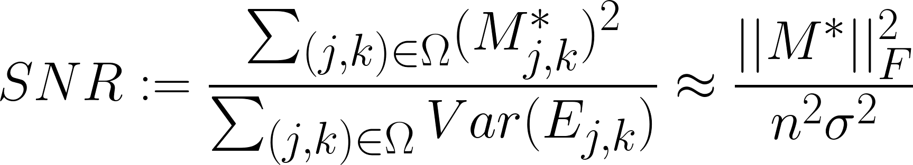
Low-Rank Matrix Completion
The empirical statistical accuracy of vanilla gradient descent in the presence of noise.

Slide 25
Contents
Introduction & Motivation
Regularized V.S. unregularized gradient method
A glimpse of implicit regularization
Results
Phase retrieval
Low-rank matrix completion
Blind deconvolution
General recipe for trajectory analysis
Discussion & Insights

Slide 26
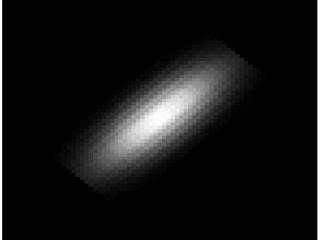
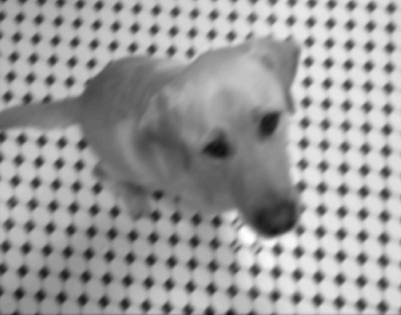
The Blind Deconvolution Problem
Deconvolution:
?
Ⓧ
=
Blind Deconvolution:
?
Ⓧ
?
=

Slide 27
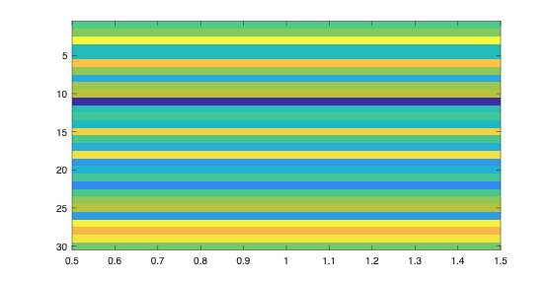
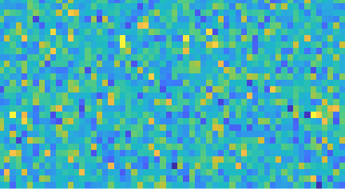
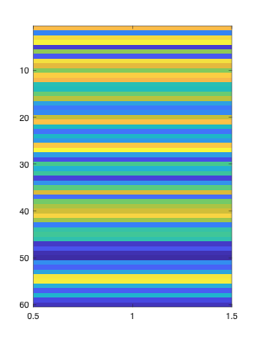
Assumptions and the Random Projection
Convolution model:
Too many unknowns!
DFT matrix
satisfies the “incoherence property”
(rows are not too correlated to h)
Random projection:
Vector in random matrix
Vector in random matrix
We assume the signals live in the same lower-dimensional subspace
=
✕
Vector in DFT matrix
Vector in random matrix

Slide 28
Solving the Optimization Problem
Actual signal
(known)
Modelled signal
(computed from h & x)
Simply the “difference” between the modelled signal and the actual signal

Slide 29
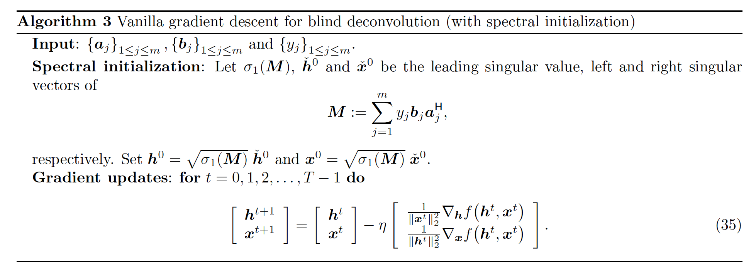
Solving the Optimization Problem
Wirtinger Gradient

Slide 30
Contents
Introduction & Motivation
Regularized V.S. unregularized gradient method
A glimpse of implicit regularization
Results
Phase retrieval
Low-rank matrix completion
Blind deconvolution
General recipe for trajectory analysis
Discussion & Insights

Slide 31
A General Recipe for Trajectory Analysis
Main challenge is to demonstrate that appropriate incoherence conditions are preserved throughout the trajectory of the algorithm
Leave-one-out perturbation allows for decoupling of the statistical dependency while controlling the component-wise incoherence measures

Slide 32
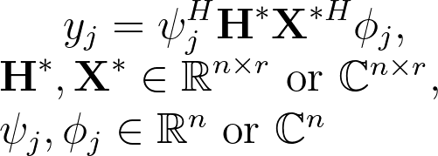
General Model
Consider the following problem with samples collected in a bilinear/quadratic form:
This model entails all three examples in this paper:
Phase retrieval:
Matrix completion:
Blind deconvolution:

Slide 33
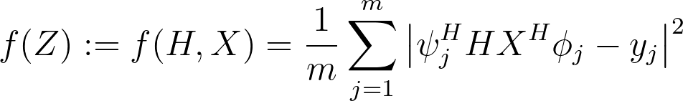

General Model (cont.)
For this setting, the empirical loss function is given by:
We minimize this using vanilla gradient descent following a standard spectral initialization:
We are now positioned to outline the general recipe in the following steps.

Slide 34
Step 1: Characterizing local geometry in the RIC
First step is to characterize region R known as the region of incoherence and contraction (RIC) such that the Hessian obeys strong convexity and smoothness
The RIC typically contains all points such that the l2 error is not too large and
(incoherence)
Each of the examples in the paper have an incoherence condition analogous to this

Slide 35


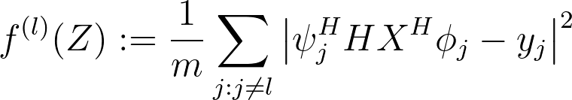
Step 2: Introducing the leave-one-out sequences
We rely on construction of auxiliary sequences to justify that no iterates leave the RIC.
For each l, produce an auxiliary sequence such that each sequence is independent of any sample involving the corresponding design vector (phi or )
We then consider the leave-one-out loss function, which discards the lth sample

Slide 36
Step 3: Establishing the incoherence condition
We are now ready to establish the incoherence condition using the auxiliary sequences.
Proof usually proceeds by induction, where we show that the next iterate remains in the RIC given that the current one does.

Slide 37
Step 3(a): Proximity between original and leave-one-out iterates
A loss iterate and its corresponding auxiliary sequence are “glued” to each other along the whole trajectory, and so are the respective gradients
This fact along with the strong convexity condition imply l2 contraction:

Slide 38
Step 3(b): Incoherence condition of leave-one-out iterates
The independence of leave-one-out iterates with respect to design vectors leads to a friendly analysis for controlling
This statistical independence is always present by the construction of leave-one-out sequences in Step (2)

Slide 39
Step 3(c): Combining the bounds
With these results in place, we apply the triangle inequality to obtain
Where the first term is controlled in 3(a) and the second in 3(b). By choosing the bounds properly, we establish the incoherence condition for all 1≤l≤m, as desired.

Slide 40
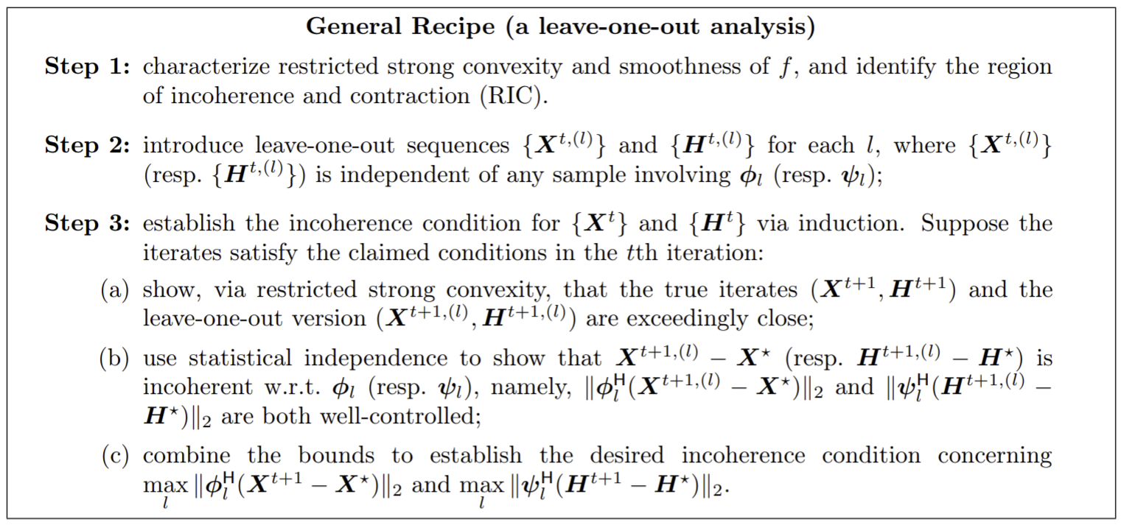
Shorthand Recipe

Slide 41
Contents
Introduction & Motivation
Regularized V.S. unregularized gradient method
A glimpse of implicit regularization
Results
Phase retrieval
Low-rank matrix completion
Blind deconvolution
General recipe for trajectory analysis
Discussion & Insights

Slide 42
Conclusion, discussion & insights
Interesting phenomenon: GDM achieves implicit regularization that gives theoretical computation complexity
More thoughts on:
Scale of capability
Leave-one-out tricks
Sample complexity
Other iterative methods and loss functions

Slide 43
Thanks
Q&A

